Slide 1

Threat Hunting, Or: How I Learned to Stop Worrying & Love ATT&CK
Cian Heasley Fraser Dumayne
Notes:
Cian & Fraser

Slide 2
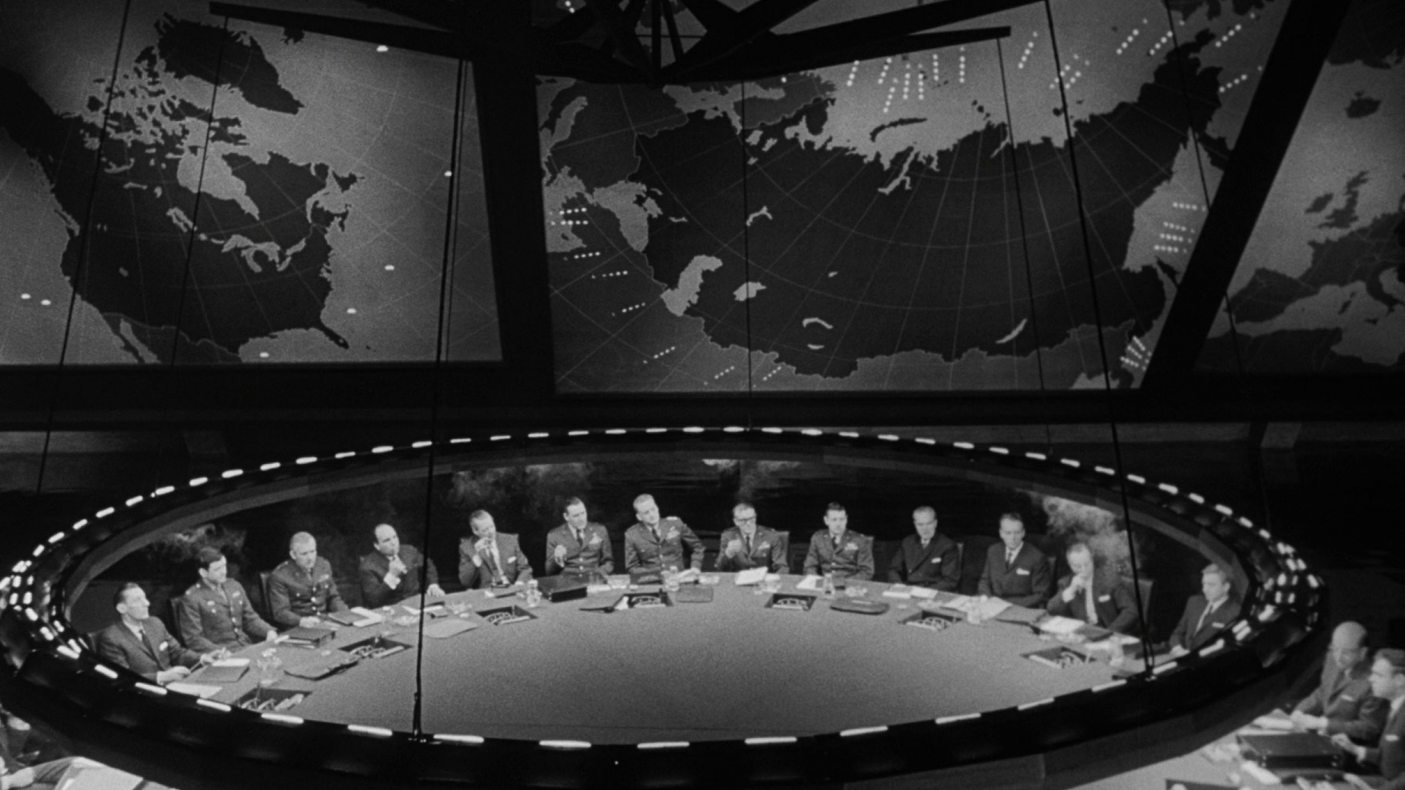


Who are we?
Fraser Dumayne
Security Engineer
Adarma
Cian Heasley
Security Engineer
Adarma
Notes:
Cian & Fraser

Slide 3
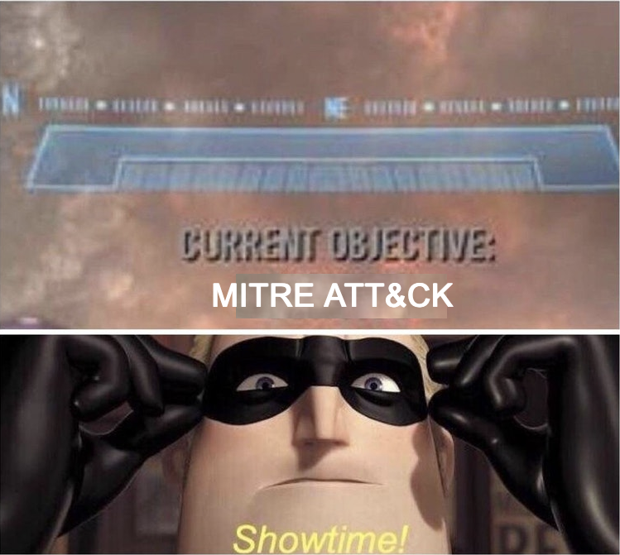
Objectives
Why the MITRE ATT&CK Framework has made our lives easier and can do the same for you.
Understand the relationship between ATT&CK data sources, technique, tactics and Splunk.
Quick case study, how ATT&CK can help us analyze recent world events.
Give a demo of how ATT&CK can help inform the creation of detections and the process of threat hunting.
Notes:
Fraser

Slide 4
What is MITRE ATT&CK?
MITRE ATT&CK is a framework made up of attack techniques which have been discovered in the real world.
Each technique is mapped to 1 or more of 12 tactics.
Each technique contains information including data sources, mitigations, detection methods, etc.
Ideal for mapping your defenses against real world attacks for increased resilience.
Notes:
Cian

Slide 5
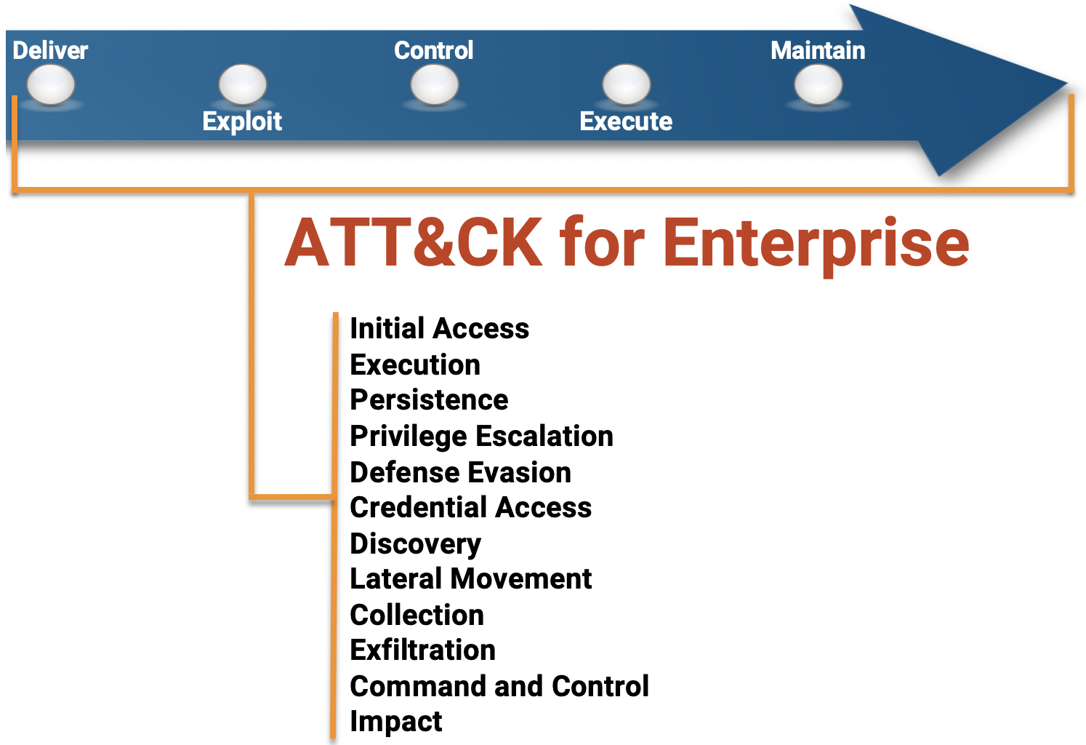
What is MITRE ATT&CK?
Techniques are organized by adversary tactic, these tactics align with the last five kill-chain phases.
Comparing ATT&CK
& the
Cyber Kill-Chain
Notes:
Cian

Slide 6
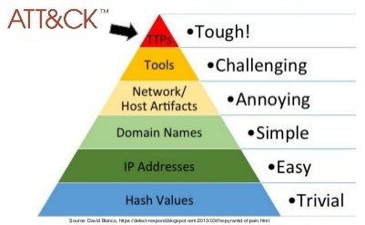
What is MITRE ATT&CK?
When we talk about tactics, techniques and procedures (TPS) we are talking about the top of the “Pyramid of Pain”, a visualisation of attack indicators and the pain caused to adversaries by their detection.
Notes:
Cian

Slide 7
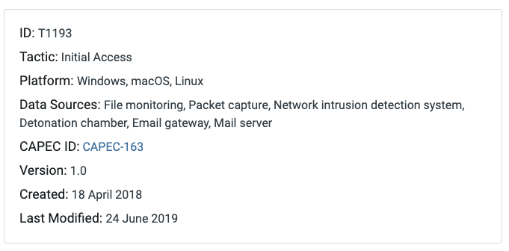
What is MITRE ATT&CK?
ATT&CK Enterprise techniques are broken down by tactic and by Windows, Linux or MacOS platforms.
Each technique has associated data sources, platforms, and a wealth of other information.
Spearphishing
Attachment
Notes:
Cian

Slide 8
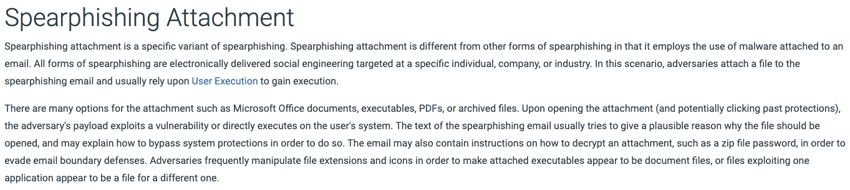
What is MITRE ATT&CK?
Procedures are the specific implementation the adversary uses for techniques or sub-techniques “in the wild”.
Notes:
Cian

Slide 9

Why MITRE ATT&CK?
MITRE ATT&CK is constantly being updated & refined.
Large, active open source research and dev community.
Common language to describe complex technical attacks.
Gives granularity when examining adversary behavior.
Can benefit Red and Blue teams.
Notes:
Fraser

Slide 10
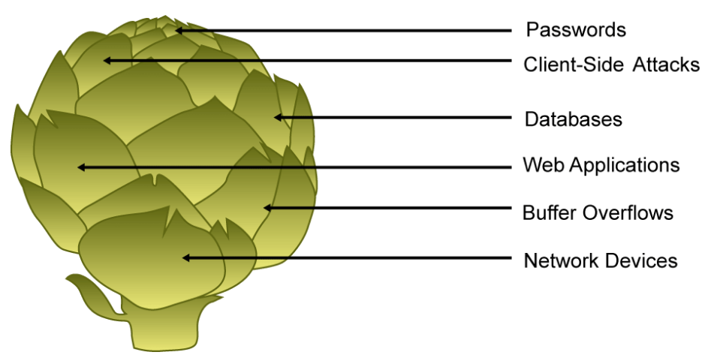
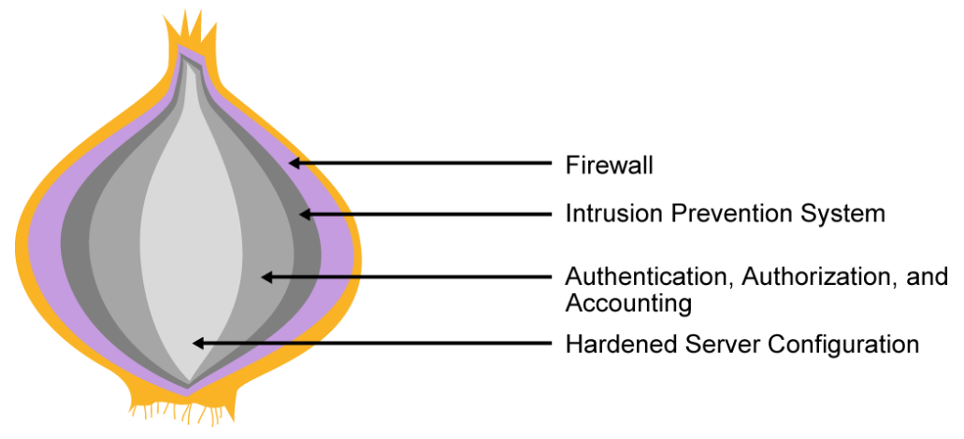
Why MITRE ATT&CK?
Need we say more:
<- ?? Artichoke ??
Cisco Onion ->
Notes:
Cian

Slide 11
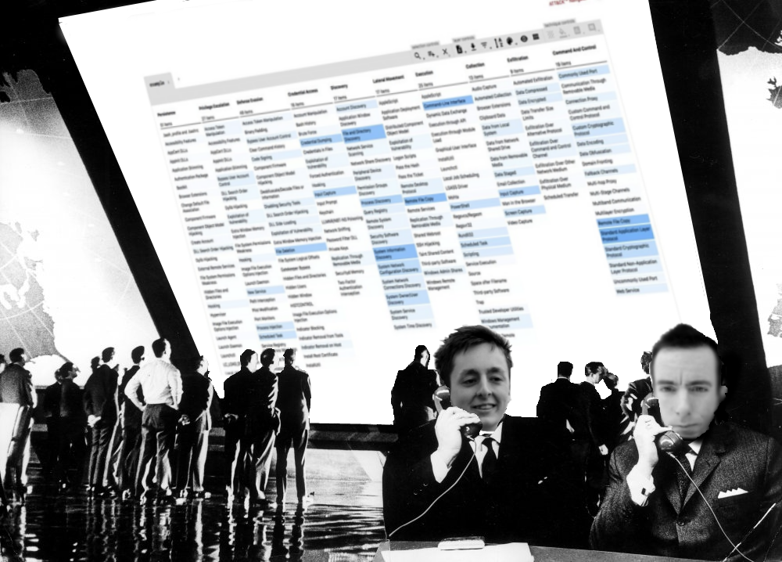
Research, research, research!
Each technique in MITRE ATT&CK is well documented (data sources, APTs, detection, etc)
You should also research online outside of ATT&CK as much as possible
ATT&CK Navigator is an ideal tool for recording & visualizing your analysis
Notes:
Fraser

Slide 12
Advanced Persistent Threats
MITRE ATT&CK contains detailed information on 94 groups & APTs which is perfect for identifying potential attackers. Examples include:
Darkhotel
APT39
Deep Panda
Lazarus Group
Each group has a list of associated techniques which have been seen in the wild as well as details of procedural usage of these techniques.
These threat group descriptions can be an ideal starting place for your threat detection.
Notes:
Fraser

Slide 13
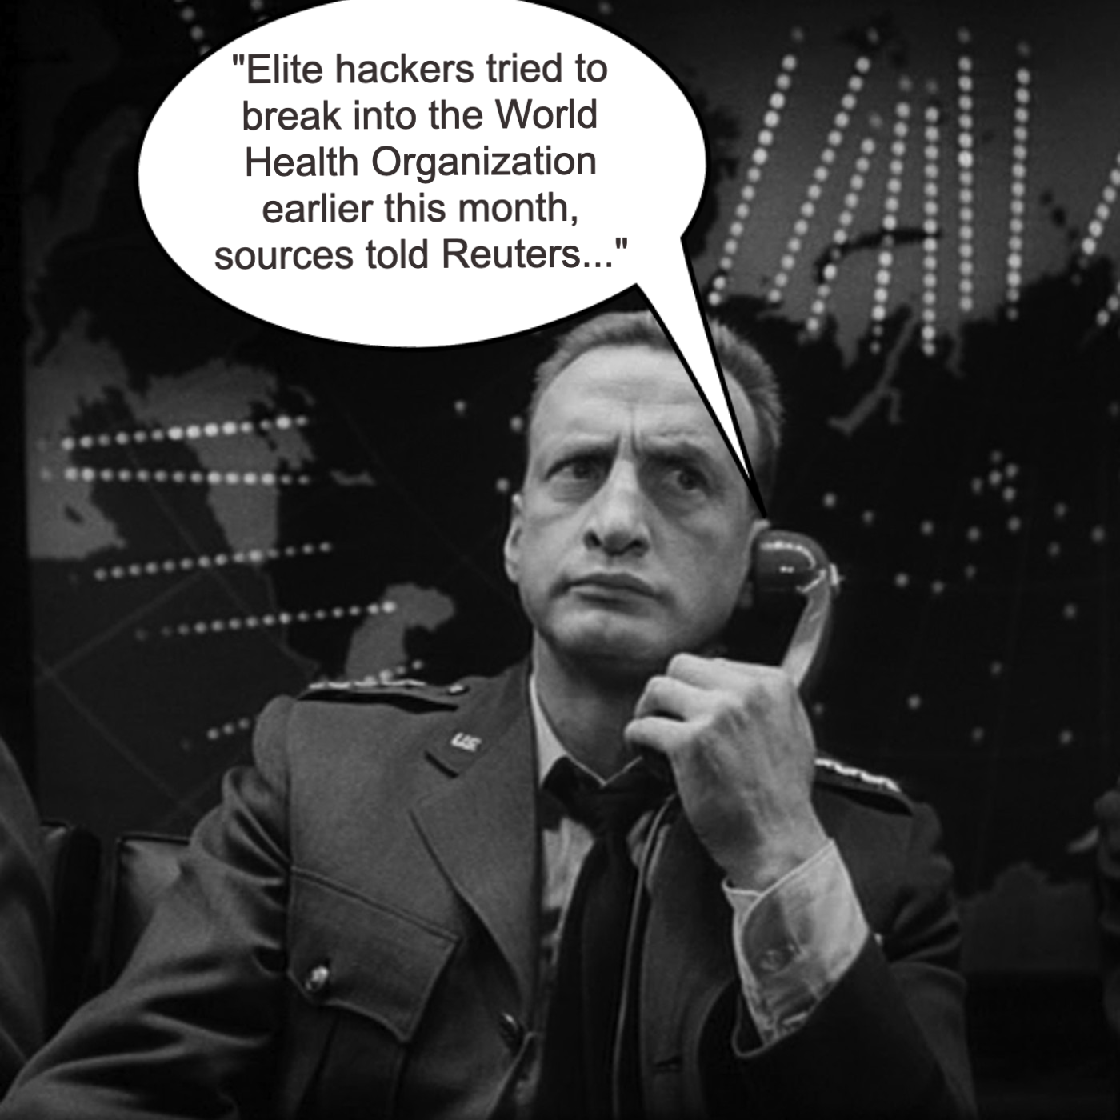
Who are Darkhotel?
“WHO Targeted in Espionage Attempt, COVID-19 Cyberattacks Spike” - Threatpost, March 14^{th, 2020}
“The attack appeared to be aimed at achieving a foothold at the agency rather than being an end unto itself...”
“... unnamed sources told Reuters that the DarkHotel group, an APT associated with carrying out cyberespionage efforts in China, North Korea, Japan and the United States, could be the culprit behind the attack”
Notes:
Cian

Slide 14



The Magic Formula!
+
Notes:
Fraser

Slide 15
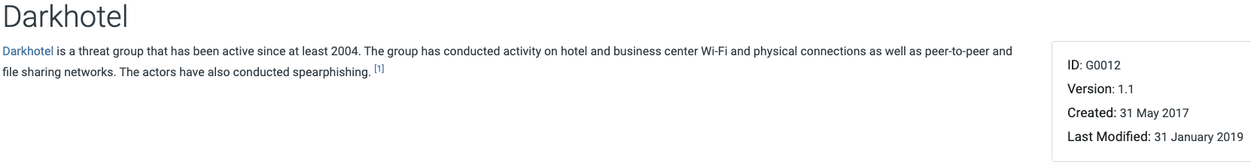
What Can ATT&CK Tell Us About DarkHotel?
ATT&CK assigns group ID numbers to prominent APTs tracked by the security community
These group IDs are linked to group aliases, software used, technique use by software and a host of other information.
DarkHotel is “G0012”:
Notes:
Fraser

Slide 16
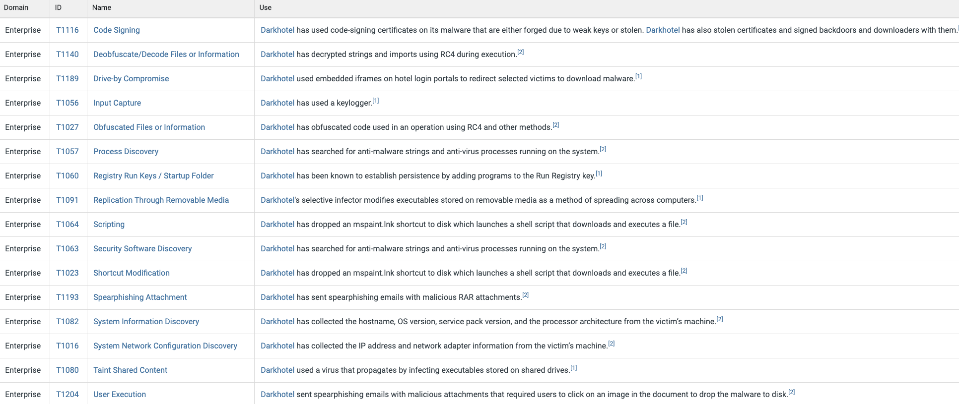
What Can ATT&CK Tell Us About DarkHotel?
Notes:
Fraser

Slide 17
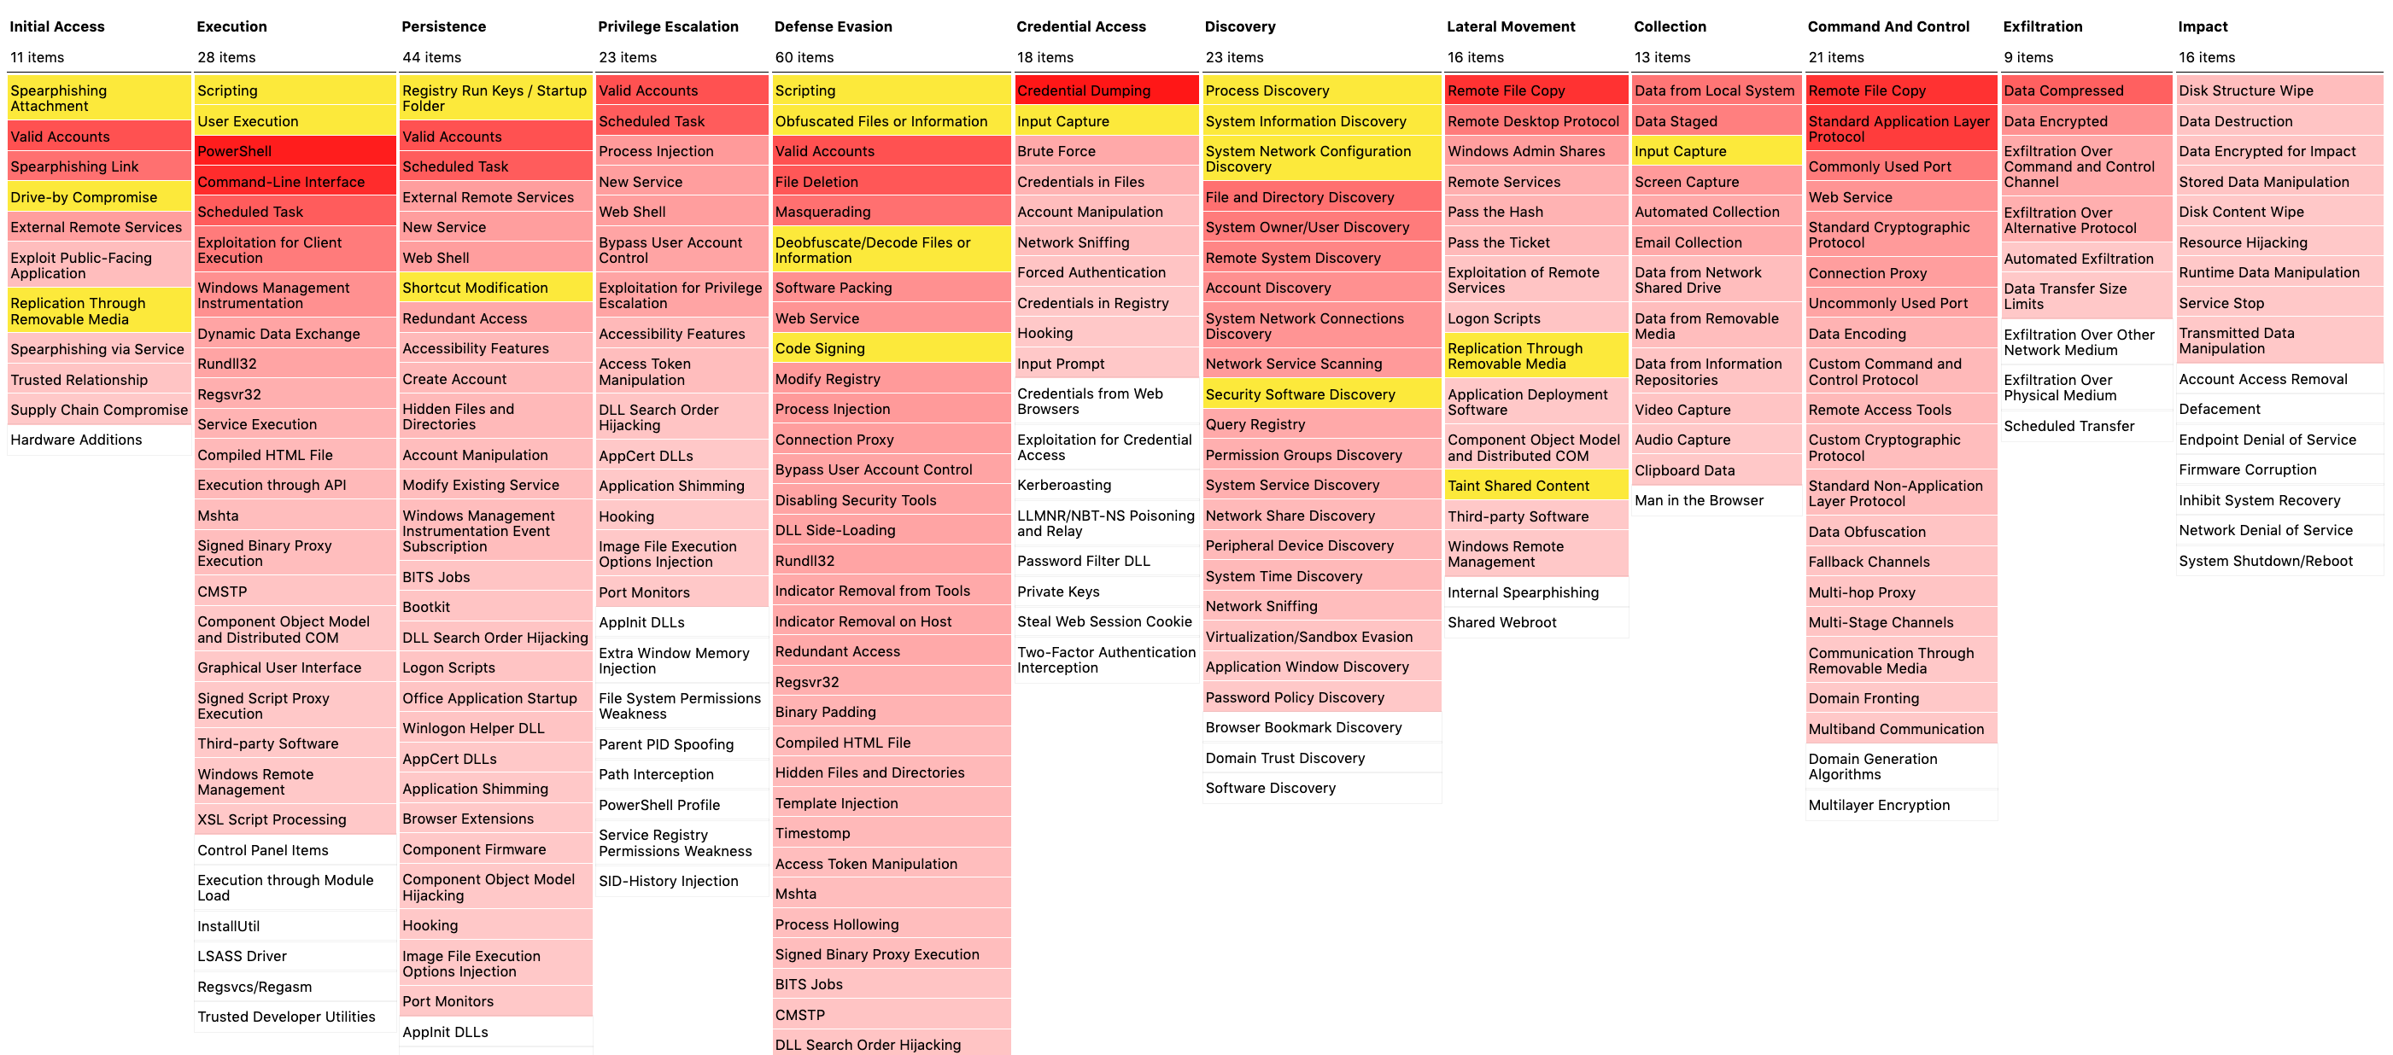
What Can ATT&CK Tell Us About DarkHotel?
= DarkHotel Techniques
Notes:
Fraser

Slide 18
Pinpointing Techniques used by DarkHotel
Based on the ATT&CK Navigator we can see that Spearphishing Attachment is a hot technique not just for DarkHotel but for all APTs.
We can use MITRE ATT&CK to discover more details about this technique and plan our defenses accordingly:
Notes:
Fraser

Slide 19
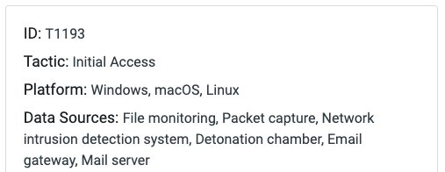
Data Sources are Crucial
MITRE contains a list of 58+ standardised data sources which are used to detect the techniques documented by ATT&CK.
Without access to the right data sources you have no chance of detecting attacks!
For detecting ‘Spearphishing Attachment’ we should have some of the sources shown here:
Notes:
Cian

Slide 20
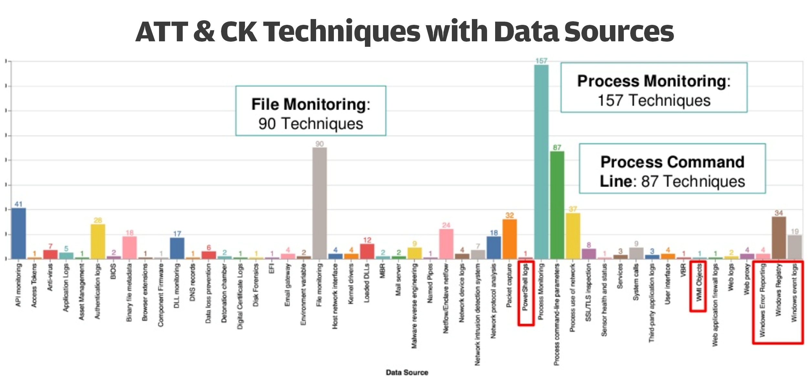
All Data Sources Are Not Created Equally
Diagram by Roberto Rodriguez
Notes:
Cian

Slide 21
Why Use ATT&CK with Splunk?
Splunk correlates real-time data across various log sources. This makes it an ideal platform for correlating with ATT&CK’s data source definitions.
Using detections covered in MITRE under each technique, we can generate Splunk searches & alerts to uncover these attacks and protect against them.
Even without live data you can practice on static sample datasets such as BoTS and Mordor.
Notes:
Fraser

Slide 22
Demonstration Overview
Learn more about the Spearphishing Attachment technique used by Darkhotel.
Analyse the BoTSv2 dataset for examples of Spearphishing Attachment.
Using information discovered using MITRE ATT&CK and other online resources to successfully identify the attack and any further damage caused
Notes:
Fraser

Slide 23
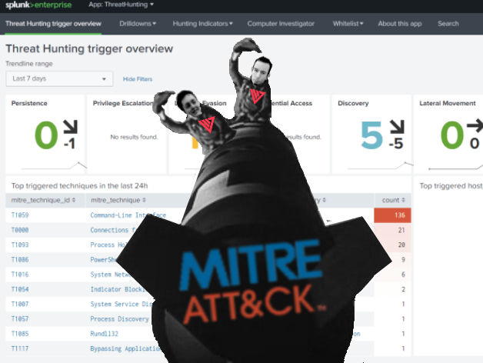
Splunk Time!
*no splunk instances were harmed during the making of this demo
Notes:
Fraser

Slide 24
Useful Resources
ATT&CK Navigator – Generate heatmaps/visualizations of techniques found in MITRE ATT&CK
DeTT&CT – Useful for generating JSON files which can be imported into ATT&CK Navigator as heatmaps.
Mordor – Pre-recorded security events generated using adversarial techniques in JSON format.
Red Canary – Small and portable detection tests for MITRE ATT&CK
Caldera – An automated adversary emulation system, built on the MITRE ATT&CK framework
Elemental - Centralized threat library of MITRE ATT&CK techniques, Atomic Red Team tests, and over 280 Sigma rules.
Notes:
Cian

Slide 25
Conclusion
MITRE ATT&CK is an excellent framework for discovering and mitigating attacks with its wealth of information.
Splunk is the ideal tool for you to set up your defences or even just practice your detections as we have shown.
Advanced Persistent Threats can offer a great starting place for you to begin your analysis. Staying up to date on recent events in cybersecurity is a huge boost to your threat hunting.
You NEED to have the correct data sources before you can begin to identify anything!
Notes:
Cian

Slide 26
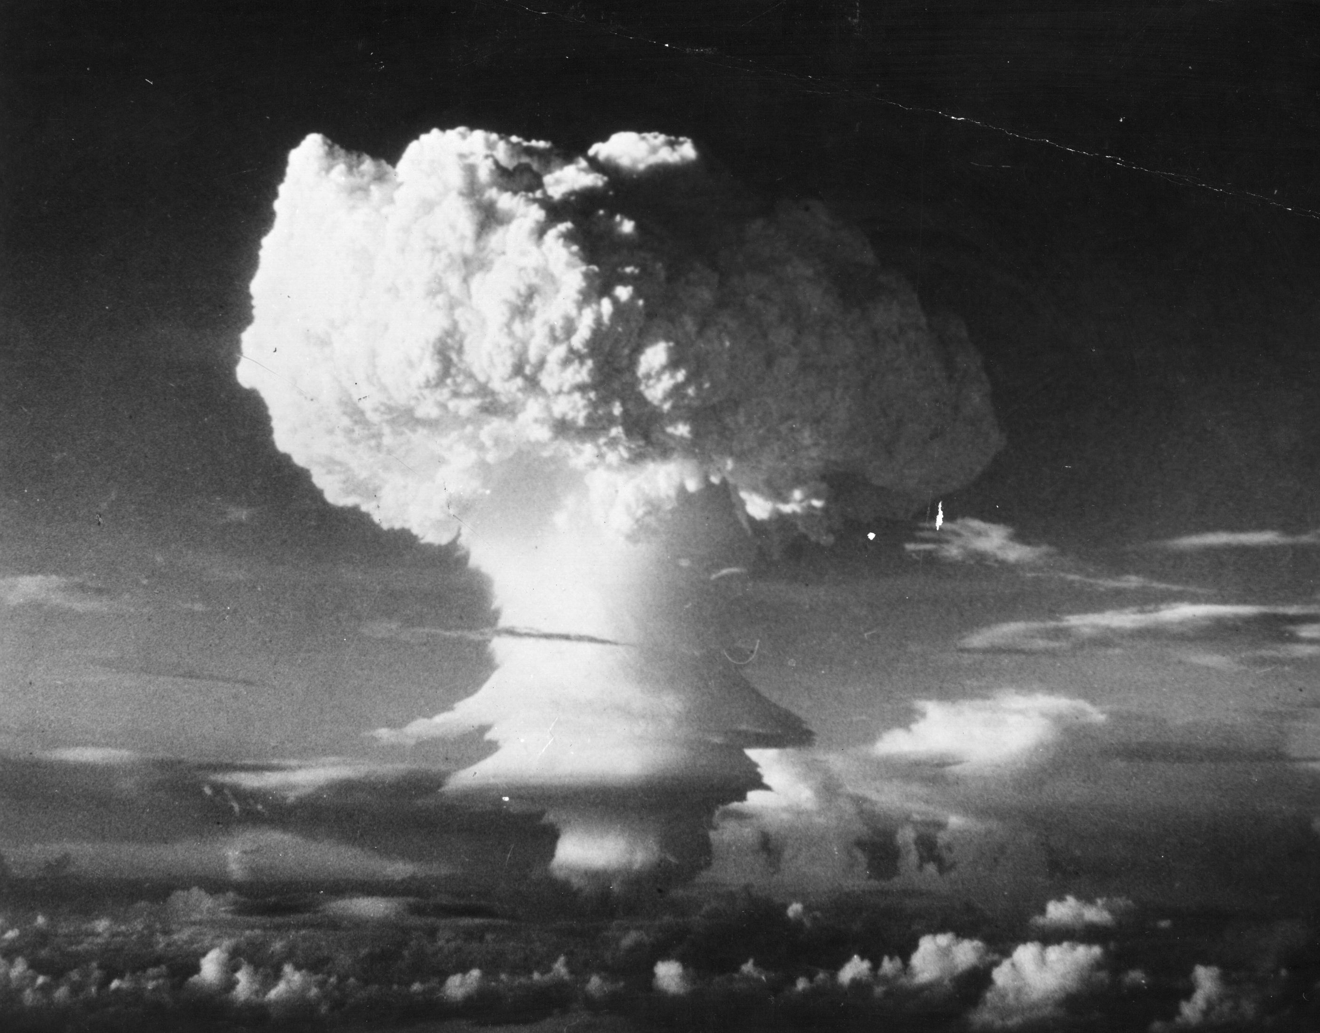
BOOM! Question Time!
Notes:
Cian & Fraser

Slide 27

Thank you for listening!
If you want to learn a bit more about MITRE ATT&CK you can check out our blog posts on the Adarma Tech Blog:
https://medium.com/adarma-tech-blog/
You can also find us on social media:
Twitter - @frazsec1 (Fraser Dumayne)
LinkedIn - Fraser Dumayne / Cian Heasley
Or message us on Teams if you work with us!
Notes:
Cian & Fraser

